Slide 1
Semester Two –
Weeks 6 & 7:
Elucidating Research Results (Findings)
Interpretation and Discussion of Results
Notes:
Delete this slide when you’ve finished preparing the other slides.

Slide 2
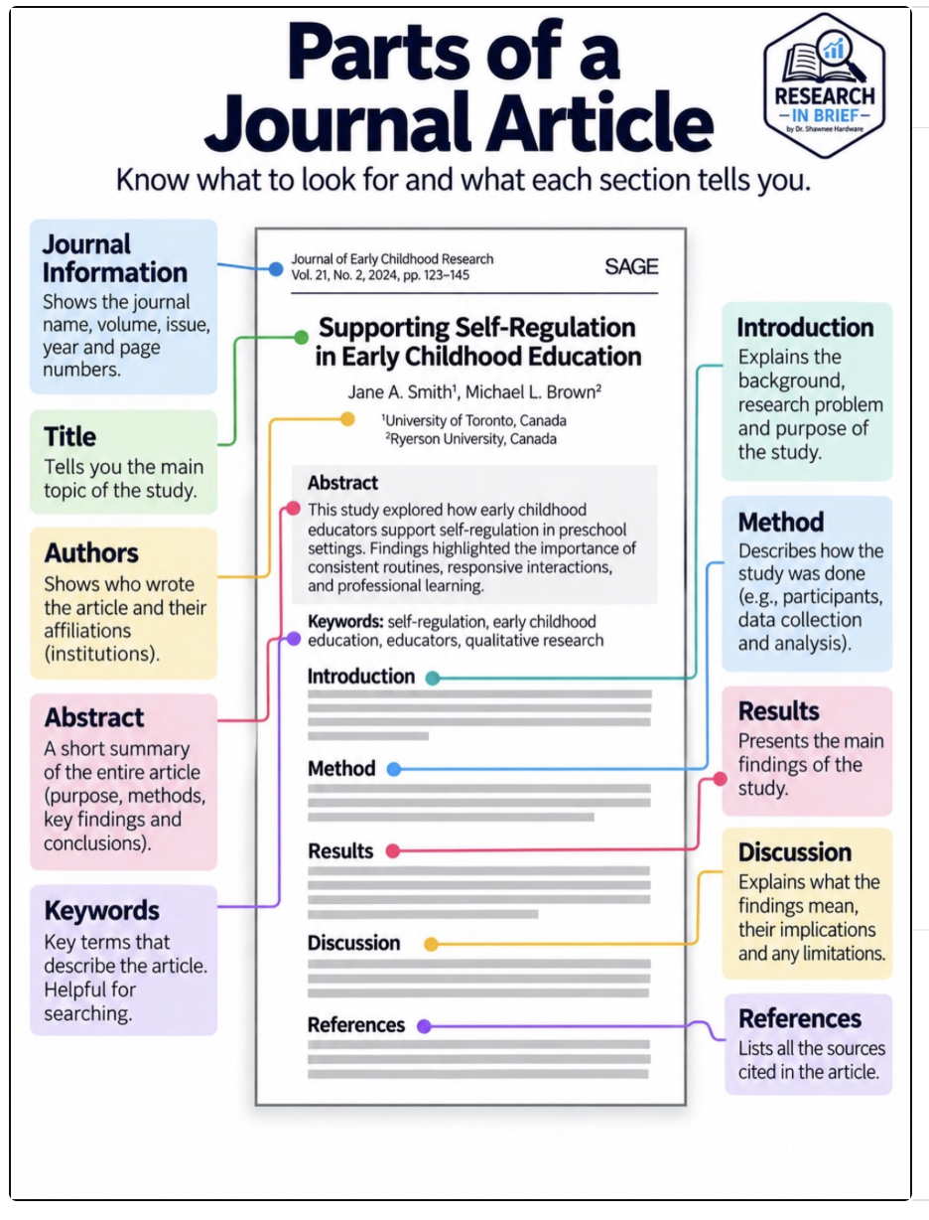

Slide 3
6. Elucidating Research Results (Findings)
I have based the following introductory notes on the prescribed text of Kumar (2011), “Chapter 17 - Writing a Research Report”.
Additional material is drawn from related citations and noted accordingly.
Effectively presenting your results or findings is crucial for highlighting the significance and implications of your research within the academic community.
This involves understanding and interpreting your findings, creating a coherent findings section, articulating results clearly and accurately, using visual aids, and placing findings within the scholarly discourse.
https://www.nu.edu/blog/how-to-present-dissertation-findings/#:~:text=Organize%20your%20presentation%20in%20a,and%20implications%20of%20your%20research.

Slide 4
Elucidating Research Results (Findings)
Generally speaking, there is no real difference between the two.
In most papers, they are used interchangeably. However, it helps to be consistent throughout the paper.
So, if you have used ‘findings’ the first time, you need to use only that throughout the paper and not switch back and forth between ‘findings’ and ‘results’.

Slide 5
Elucidating Research Results (Findings)
Technically or academically speaking, ‘findings’ seems to be used more for qualitative studies whereas ‘results’ seems to be used more for quantitative studies.
For example, in an IT study, you may say ‘It was found that when IT executives aimed to build rapport with staff, it led to positive performance 72% of the time compared with 38% of the time when no rapport was built.’
On the other hand, for another IT study, you may say ‘The combination of X and Y results in outcome Z.’
For more information on this distinction, you may refer to the work done by (McGregor, 2018).
https://methods.sagepub.com/book/mono/understanding-and-evaluating-research/chpt/13-results-findings

Slide 6
A. Purpose of the Findings Section
The findings section serves as the factual heart of a research study.
According to Kumar (2011), the primary purpose of this section is to present what was discovered through data collection without engaging in interpretation or explanation (p. 258).
This means showing the evidence, not discussing what it means that comes in the discussion chapter.
Creswell (2009) emphasises that the findings should be “presented objectively, in an unbiased manner, and free of personal opinions”.
All data must directly relate to the research questions or hypotheses formulated during the planning stage.
Credit: https://www.cultureamp.com/blog/what-is-a-likert-scale

Slide 7
B. Structuring Findings According to Research Objectives
A systematic structure is recommended where each subsection aligns with a specific research objective.
This strategy aids coherence and logical flow and helps the reader to trace how each finding emerged.
You should:
Introduce the objective or research question
Present the relevant data (including frequency counts, quotes, or statistics)
Support with visuals (e.g., word frequency charts from NVivo or cross-tabulations in SPSS)

Slide 8
B. Structuring Findings According to Research Objectives
IT Example:
If the research objective is "To explore the perceptions of IT educators on the use of virtual labs", the findings may include:
  A frequency table showing how many participants prefer virtual labs over physical labs
  A word cloud generated in NVivo with dominant themes like "accessibility," "scalability," and "technical issues"
  Excerpts of participant narratives, such as "Virtual labs allow my students to experiment without fear of damaging equipment."

Slide 9
C. Visual Representation of Data
Ensure to balance textual narrative with visual aids to enhance comprehension.
Present the data through graphs, charts, and tables to simplify complex datasets
Use clear labels and consistent formatting.
Quantitative Visuals:
Qualitative Visuals:
• Bar charts: e.g., distribution of IT graduates across specialisations
• Line graphs: e.g., change in student performance before and after using AI tutors
• Pie charts: e.g., breakdown of preferred development frameworks among developers
• Thematic matrices (NVivo/Atlas.ti): e.g., mapping of interview themes related to "cybersecurity concerns"
• Code frequency tables: e.g., listing themes like “system downtime,” “user resistance,” “automation benefits” by number of sources

Slide 10
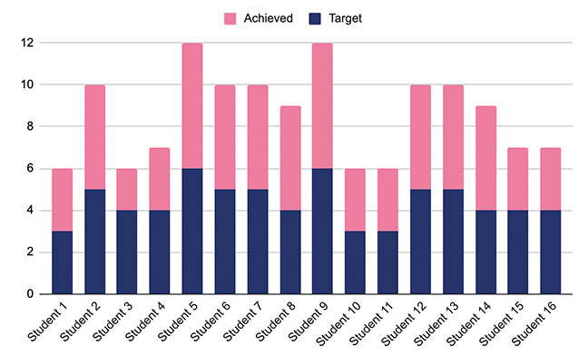
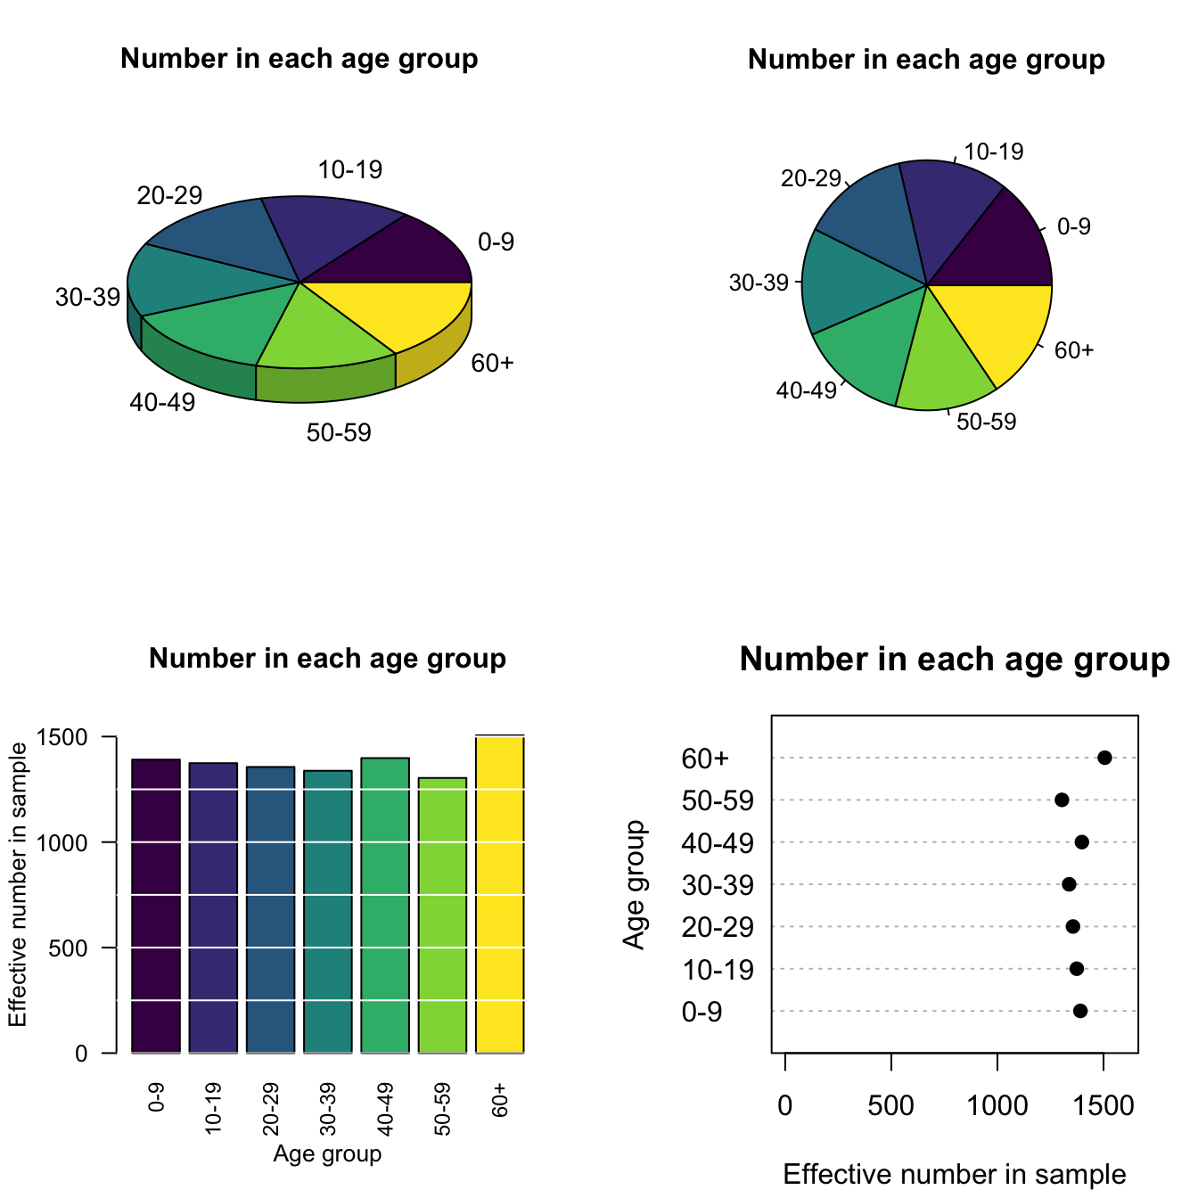
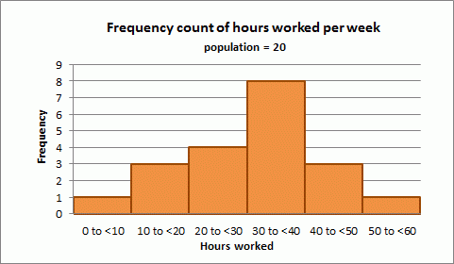
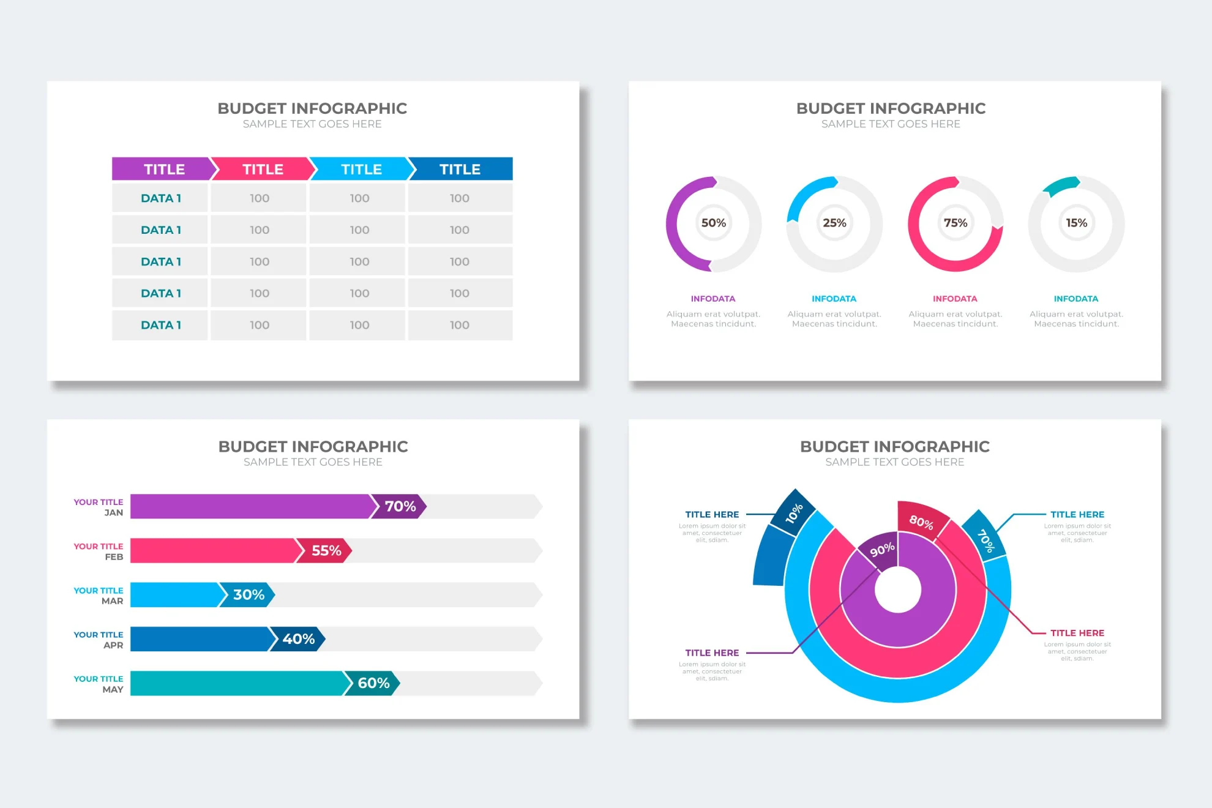

Slide 11
D. Academic Style in Writing
According to Cohen et al. (2017), it is critical that findings be accurate, verifiable, and unbiased, especially in educational and scientific disciplines (p. 482).
You should:
  Use a neutral, third-person academic voice
  Avoid making interpretations or assumptions
  Clearly attribute data to participants or datasets (e.g., P4, Q12)
  Mention data collection methods (e.g., focus group, system logs, survey tool)
Confidentiality is crucial in IT-related research, especially when handling sensitive data like user behaviour logs, server response times, or access rights.
Data should be anonymised, coded properly, and referenced ethically.

Slide 12
E. IT-Relevant Examples for Elucidating Findings
Quantitative Example:
A researcher measuring the response time of different cloud services might present:
Figure 4.3
“Figure 4.3 illustrates the average response times in milliseconds for AWS, Azure, and Google Cloud during peak traffic periods. As observed, AWS maintained a consistent response time below 200ms, whereas Azure peaked at 350ms during high traffic intervals.”
Cloud Service | Average Response Time (ms)
AWS | 190
Azure | 350
Google Cloud | 275

Slide 13
E. IT-Relevant Examples for Elucidating Findings
Qualitative Example:
For interviews with IT administrators about implementing cybersecurity protocols:
“A common theme emerging from 8 out of 10 participants was the burden of policy compliance. As one administrator (P6) noted, 'We spend more time ensuring tick-box compliance than mitigating real threats.' This theme is visualised in Figure 5.2”
Theme | Number of Participants Mentioning It
Burden of Policy Compliance | 8
Lack of Real-Time Threat Response | 6
Resource Constraints | 5
Training and Awareness Gaps | 4
Overly Complex Policy Language | 3
Figure 5.2

Slide 14
F. Software Tools for Presenting Findings
Researchers can use various digital tools to format and illustrate findings.
These include:
NVivo – word clouds, thematic matrices – Qualitative Research
Atlas.ti – code-document tables – Qualitative Research
Excel/SPSS – charts for survey data – Quantitative Research
Tableau – interactive dashboards (particularly useful for live presentations) – Quantitative Research

Slide 15
G. In conclusion
Do not mix interpretation with findings
  e.g., avoid phrases like “This suggests…”
Don’t overload the section with too many quotes or stats
  be selective
Avoid unexplained visuals
  every chart/table must be contextualised.

Slide 16
Let’s proceed to the
Interpretation and Discussion of Results (Findings)

Slide 17
Interpretation and Discussion of Results (Findings)
For Week 7, I have based the following introductory notes on the prescribed text of Kumar (2011), “Chapter 17 - Writing a Research Report”.
Additional material is drawn from related citations and noted accordingly.
Kumar (2011) suggests that, as a beginner in research methods, it is important for you to understand these procedures and the assumptions behind them so that you can make appropriate and accurate interpretations of the findings.

Slide 18
Interpretation and Discussion of Results (Findings)
Conversely, Creswell (2009) indicates that qualitative approaches to data collection, analysis, interpretation, and report writing differ from traditional, quantitative methods.
In interpreting data, researchers need to provide an accurate account of the information.
This accuracy may require debriefing between the researcher and participants in quantitative research.
It may also involve, in qualitative research, using one or more strategies to check the data's accuracy with participants or across different data sources.

Slide 19
A. Making Sense of the Data
After presenting your findings (Week 6), the next step is to interpret their meaning.
According to Kumar (2011), interpretation is the process of making sense of numerical or thematic patterns and understanding their implications.
In qualitative research, this involves identifying what the themes suggest about the phenomenon studied,
while in quantitative research, it entails analysing statistical relationships and trends in the data.

Slide 20
A. Making Sense of the Data
ICT Example (Qualitative):
If a study explored students' perceptions of AI-based plagiarism detection tools,
interpretation may involve explaining what recurring themes (e.g., “trust in the system,” “perceived fairness,” or “lack of understanding”) reveal about how students engage with academic integrity technologies.

Slide 21
A. Making Sense of the Data
Example:
Qualitative Interpretation of Themes: Students’ Engagement with Academic Integrity Technologies
Theme 1: "Trust in the System.”
“I just hope Turnitin knows what it’s doing. I’m scared to even quote something now.” (Participant 4)
This theme suggests that students’ trust in AI systems plays a crucial role in shaping their behaviour. When trust is low, students may over-correct their writing, avoid paraphrasing, or become anxious during submissions. This reveals a compliance-based engagement rather than genuine academic development, where students are focused more on “not being caught” than learning proper citation practices. It also implies that the black-box nature of many AI tools undermines confidence in the fairness of outcomes.

Slide 22
A. Making Sense of the Data
ICT Example (Quantitative):
If a study explored students' perceptions of AI-based plagiarism detection tools,
interpretation may involve explaining what recurring themes (e.g., “trust in the system,” “perceived fairness,” or “lack of understanding”) reveal about how students engage with academic integrity technologies.

Slide 23
A. Making Sense of the Data
Example:
ICT Quantitative Example: Interpreting Lecturer Dissatisfaction with AI Grading Tools
Survey Finding:
75% of lecturers (n = 150) reported dissatisfaction with AI grading tools, rating them as “inaccurate” or “very inaccurate” on a 5-point Likert scale.
The high dissatisfaction rate (75%) suggests systemic concerns rather than isolated issues. This quantitative insight reinforces that AI tools, while efficient, need clearer logic, flexible rubrics, and human oversight to gain wider acceptance. The numbers show that dissatisfaction is rooted not just in performance, but also in pedagogical values and expectations.

Slide 24
B. Linking Findings to Research Objectives
Effective interpretation requires that findings are tied explicitly back to your original research objectives. This demonstrates logical continuity and a clear research “golden thread.”
For each objective, you should:
Summarise what the data reveals.
Compare this to what you expected based on your literature review or research aim.
Reflect on the implications for the research problem.

Slide 25
B. Linking Findings to Research Objectives
Example:
If one research objective was
“To assess student engagement with AI tools in programming assignments,”
and your findings show low usage due to unfamiliarity with the tools,
your discussion must reflect this in relation to institutional training gaps.
“The interview data revealed that the majority of students used AI programming tools rarely or not at all. When probed further, students attributed this to unfamiliarity with the tools’ functions and uncertainty about their academic legitimacy. This finding directly ties back to the objective of assessing engagement. It strongly suggests that any effort to increase AI tool usage must begin with formal integration into curricula, hands-on tutorials, and clear institutional guidelines that demystify their use in academic work. Without addressing these training gaps, students will continue to underutilise AI tools, even if their potential benefits are widely acknowledged.”

Slide 26
C. Comparing with Existing Literature
According to Cohen et al. (2017), the discussion should not occur in isolation.
Engage critically with other studies and ask,
  “Did your findings support or contradict prior research?”
This helps position your work within the wider academic conversation.

Slide 27
C. Comparing with Existing Literature
Example:
If your study reveals that AI tools reduce marking time for lecturers, you might compare this with earlier findings by Creswell (2009), who notes that technology can streamline educational administration, but that user adaptation is key.
This critical comparison strengthens your argument and showcases your academic maturity.

Slide 28
D. Drawing Valid Inferences
While interpretation involves analysis, it is crucial to avoid overgeneralising findings, especially in small-scale or qualitative studies.
Qualitative interpretations should rely on rich, contextual data, and quantitative claims must be backed by statistically significant evidence.

Slide 29
D. Drawing Valid Inferences
Do not say: “All students prefer AI tools.”
Do say: “Among the 24 students interviewed, most expressed a preference for AI-supported feedback tools due to immediate responses.”
This distinction is particularly important for maintaining ethical and scholarly credibility (Kumar, 2011).

Slide 30
E. Ethical Presentation of Results
Your interpretations should maintain academic honesty.
Avoid “cherry-picking” data or using persuasive language that skews the objectivity of your study.
It is essential to present interpretations in cautious, balanced language that respects the limitations of your data.
https://www.nu.edu/blog/how-to-present-dissertation-findings/#:~:text=Organize%20your%20presentation%20in%20a,and%20implications%20of%20your%20research.

Slide 31
E. Ethical Presentation of Results
Example Phrasing:
“These results suggest that…”
“It appears that…”
“Participants seemed to feel…”
This cautious tone aligns with the ethical principle of non-malfeasance and supports academic rigour.

Slide 32
F. A practical example of interpreting qualitative results:
Research Objective:
To investigate how undergraduate IT students perceive the use of AI tools for automated feedback in programming assessments.
Finding:
The majority of participants reported appreciating the immediate feedback provided by AI tools, but expressed concerns about the accuracy and contextual relevance of such feedback.

Slide 33
F. A practical example of interpreting qualitative results:
Interpretive Paragraph:
The findings show that undergraduate IT students value the instant responses provided by AI-based feedback tools in programming assessments; however, some scepticism remains about the reliability of the feedback for complex coding problems. This indicates a dual perception: students appreciate the efficiency of AI tools yet question their pedagogical usefulness. This interpretation aligns with Creswell’s (2009) assertion that technology adoption in education must be suitable for the context and sensitive to users to be effective. Similarly, Kumar (2011) notes that data should be interpreted considering the participants’ environment and the nature of the research problem, especially in emerging fields such as educational AI. Therefore, the discussion supports the idea that while AI introduces innovation into assessment practices, its effectiveness still depends on how well it can adapt to students’ nuanced needs and expectations.

Slide 34
F. A practical example of interpreting quantitative results:
Research Objective:
To determine whether there is a correlation between the number of hours spent using online assessment platforms and student performance in ICT modules.
Finding:
“A moderate to strong positive correlation (r = 0.62) was found between the number of weekly hours spent on platforms like Moodle Quizzes or HackerRank and students' final grades in the ICT module. This relationship was statistically significant, with a p-value less than 0.01, indicating that the likelihood of this result occurring by chance is less than 1%.”

Slide 35
F. A practical example of interpreting quantitative results:
Interpretive Paragraph:
The quantitative data analysis reveals a moderately strong positive correlation between the number of hours students engage with online assessment platforms and their academic performance in ICT modules. This suggests that greater use of these tools may support student learning and outcomes, possibly due to increased practice opportunities and immediate feedback loops. According to Cohen, Manion, and Morrison (2017), establishing such statistical relationships can inform instructional strategies and resource allocation in educational technology. Creswell (2009) also emphasises the importance of linking statistical findings to practical outcomes, especially in applied fields such as computer science education. However, while the result is statistically significant, causation cannot be inferred without further experimental research. These findings align with prior studies that suggest consistent use of digital platforms contributes to enhanced performance in technical subjects.

Slide 36
See you next time for our last lecture on…
Conclusion and Recommendations

